Slide 1

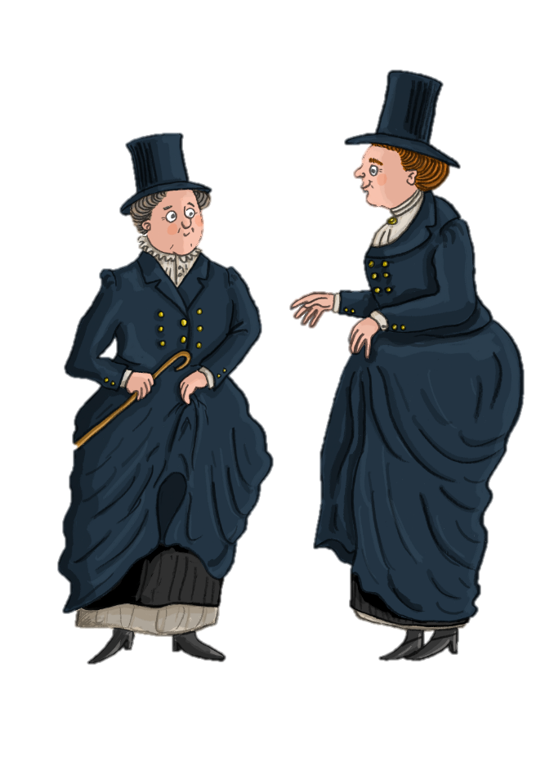



Ladies of Llangollen
Champions of the Picturesque
The Ladies of Llangollen were Champions of the Picturesque, but what does this mean? Let’s find
out more…

Slide 2
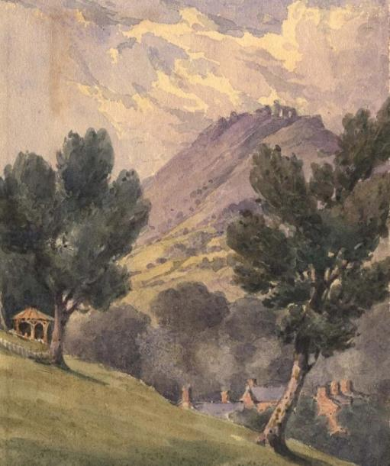
A Picturesque Retreat
The Picturesque was the height of fashion in 1780, made popular by William Gilpin and other romantic writers.
Picturesque landscapes were full of variety and surprise with something different around every corner, a strong contrast to the earlier, formal French style gardens.
In Eleanor’s diary she tells us that they enjoyed the picturesque beauty of their garden with their rose beds and the wild natural areas.

Slide 3
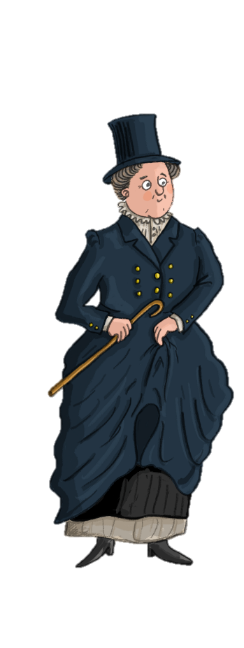

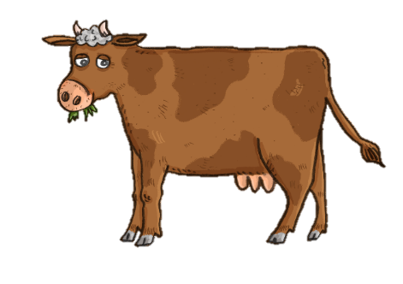
Kitchen garden and fields
The Ladies were romantics who wanted to live within the Picturesque landscape, in harmony with the seasons. They set about transforming the house and gardens creating a miniature estate with a shrubbery and gardens.
Winding gravel paths led through the kitchen garden with four separate enclosures for fruit, vegetables and flowers. Cows grazed the field in front of the house and milk products were churned in the rustic Dairy.
The kitchen garden
and fields at Plas Newydd were important to the Ladies of Llangollen. They ate the food they produced and sold potatoes for extra income

Slide 4
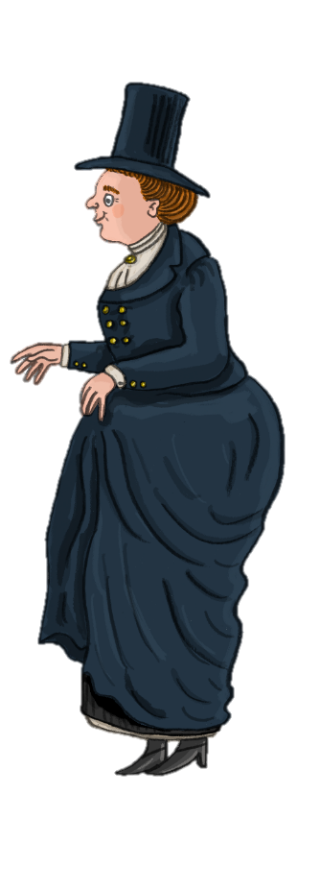
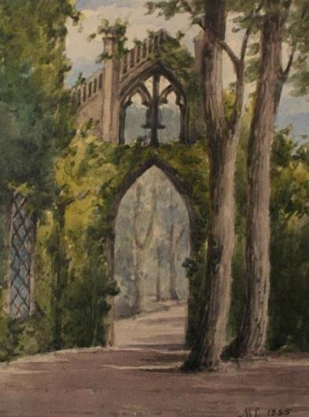
Georgian Shrubbery
Here the Ladies could enjoy the sights and fragrances of the shrubbery, a wonderful collection of lilacs, laburnum, broom and 44 different variety of roses planted alongside crocuses, wood anemones and primroses.
The planting was inspired by the garden of Woodstock, Sarah's uncle and aunt's house in Ireland. At the side of the house was a Gothic arch with a bell, used to summon the gardener. The gardens were so impressive that Queen Charlotte requested her own copy of the garden plans!

Slide 5
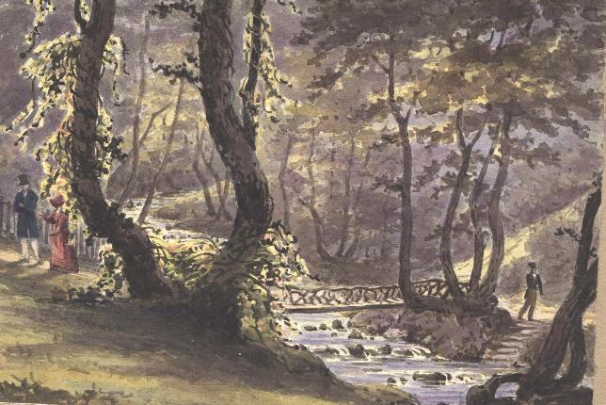
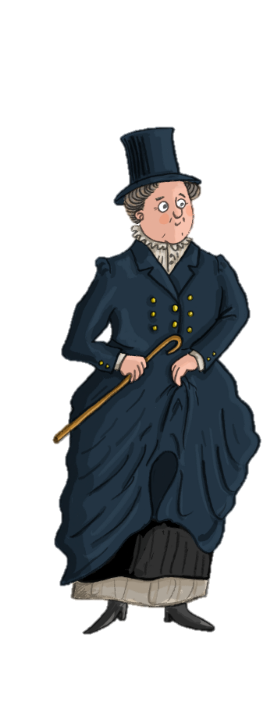

The Dell
With work on the shrubbery and kitchen gardens completed, the Ladies turned their attention to the Dell.
The Cyflymen stream was the perfect backdrop for a wild, woodland garden. Waterfalls were enhanced, pools were deepened, inscribed benched were built and paths were created to crisscross the stream over wooden bridges.
We also added features like the urn and font from Valle Crucis Abbey and had a Summerhouse built with a small library inside!

Slide 6
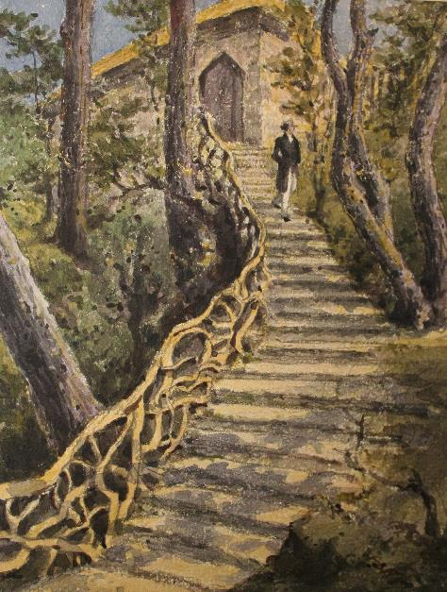
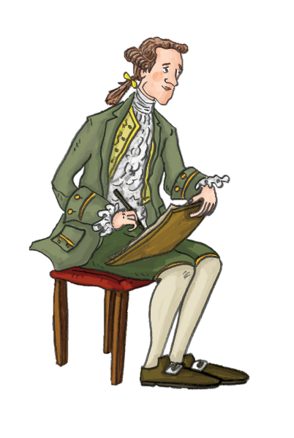
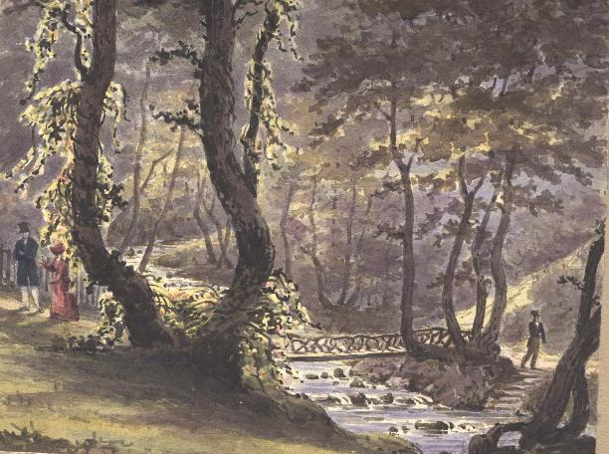
We know so much about the gardens and what they looked like because of the many written and artistic records. Visitors enjoyed painting the gardens and Dell, as well as detailed descriptions in Eleanor’s diaries.
Lady Leighton paintings

Slide 7

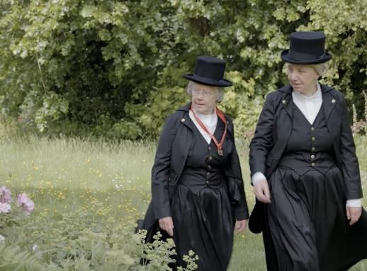
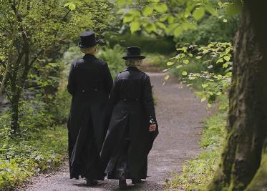
Activity 1:
First read through the questions on the next slide as a class and check the meaning of any new words. Then watch the film, created using extracts from Eleanor’s diary and answer the questions.
Watch
Champions of the Picturesque

Slide 8

1. What are the Ladies going to
show and tell us about in this short film?
2. What animals do they have?
3. Who plans the planting scheme of the garden?
4. What do they grow?
5. How many varieties of rose do they grow?
6. In the rustic dairy what does the machine make?
7. What present did their friend send
them with a poem attached?
8. In the Dell there is a rustic urn, where did
they ‘borrow’ it from?
9. What makes the Cyflymen brook
more picturesque?
10. What other picturesque features did
you notice on their tour?

Slide 9
Teacher Notes – Champions of the Picturesque
Plan a visit:
You can plan a visit to Plas Newydd Historic House and gardens in Llangollen. There are options for self-guided visits or guided tours. Please see the Visiting Plas Newydd activities for more information.
Post visit activity:
Write a diary entry to record what happened on your visit to Plas Newydd.
Use your senses to help record the day, what did you see, hear, smell, touch and taste?
Answers to the Champions of the
Picturesque task:
Home circuit, ornamental farm, grounds and gardens
Hens, cows, dogs
Sarah Ponsonby
Asparagus, cucumber, vines (grapes), gooseberries, potatoes
44
Butter
A cow – called Linda
Valle Crucis Abbey
Tumbled rocks and frothing waters
Bridges, winding paths, flowers (wild and planted), trees, views and vistas of the scenery, Dinas Bran Castle.

Slide 10
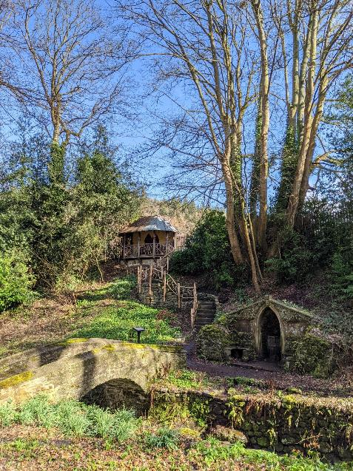
Activity 2:
Design and plan your own garden and wild area.
Draw out a garden plans like Sarah did for Queen Charlotte.
What would you grow and why?
What features would you have?
What parts of the garden would be special and important to you?
When you have finished your plans, show a partner and share your plans with each other.

Slide 11

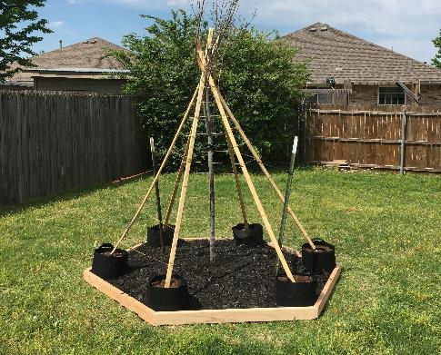
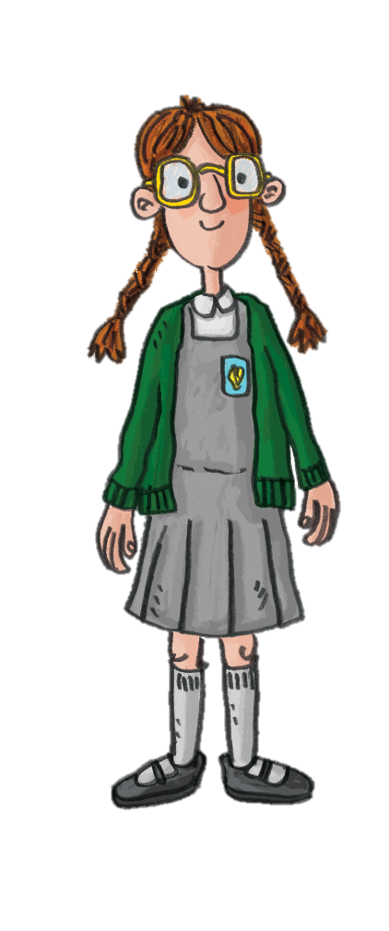
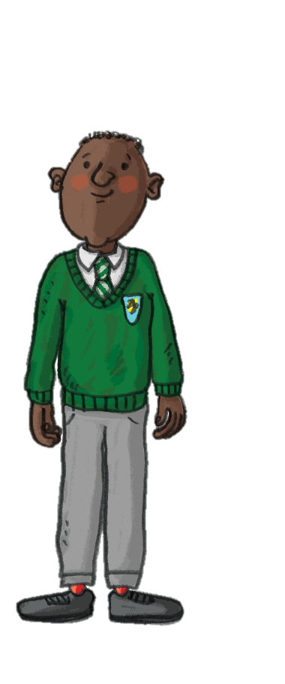

Extension Task
Sow some seeds in large pots and watch them grow.
Here are some examples of what you could grow:
Dwarf French bean
Peas
Sunflower
Sweet peas
Consider the following:
What does a plant need to grow? How tall can
it grow? How it is pollinated? Where would it be best to put it and will you need to move it as it grows? Which parts, if any, are edible?
You could
create a fun shelter as a class by making a
plant tepee!

Slide 12
Extension Task – Continued
Pupils can create a table (see example) to record how their plant grows. At the end, you can use this data to work out averages of the time to germinate/bud/flower/fruit or the height.
Plant Name: Pea
Date | Number of Days | Height in Centimetres | Notes
09.05.24 | 0 | 0cm | planted
16.05.24 | 8 | 0.5cm | First shoot sprouts
20.05.24 | 12 | 3cm | First leaf
10.06.24 | 33 | 27cm | First flower
08.07.24 | 61 | 45cm | First ripe pea pod

