Slide 1
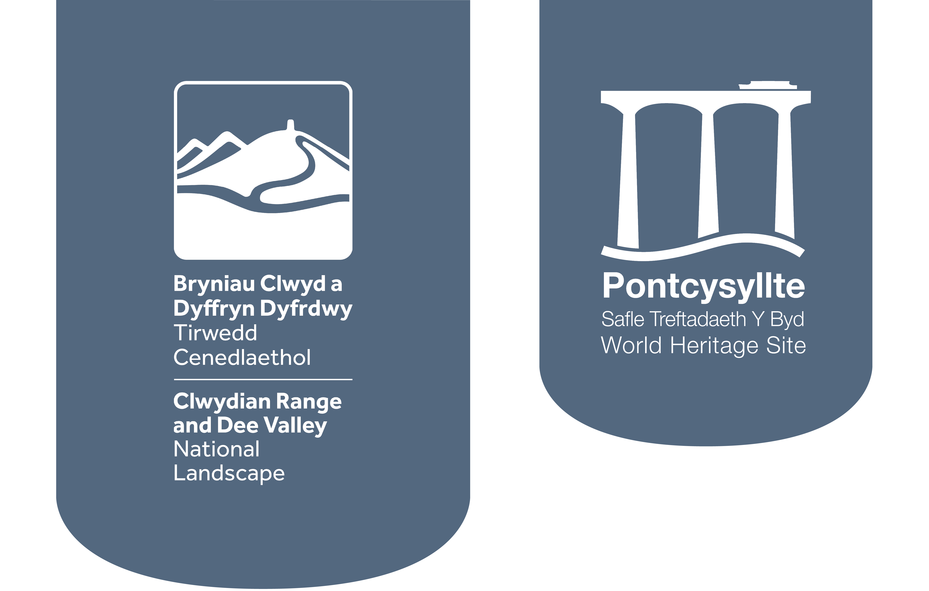
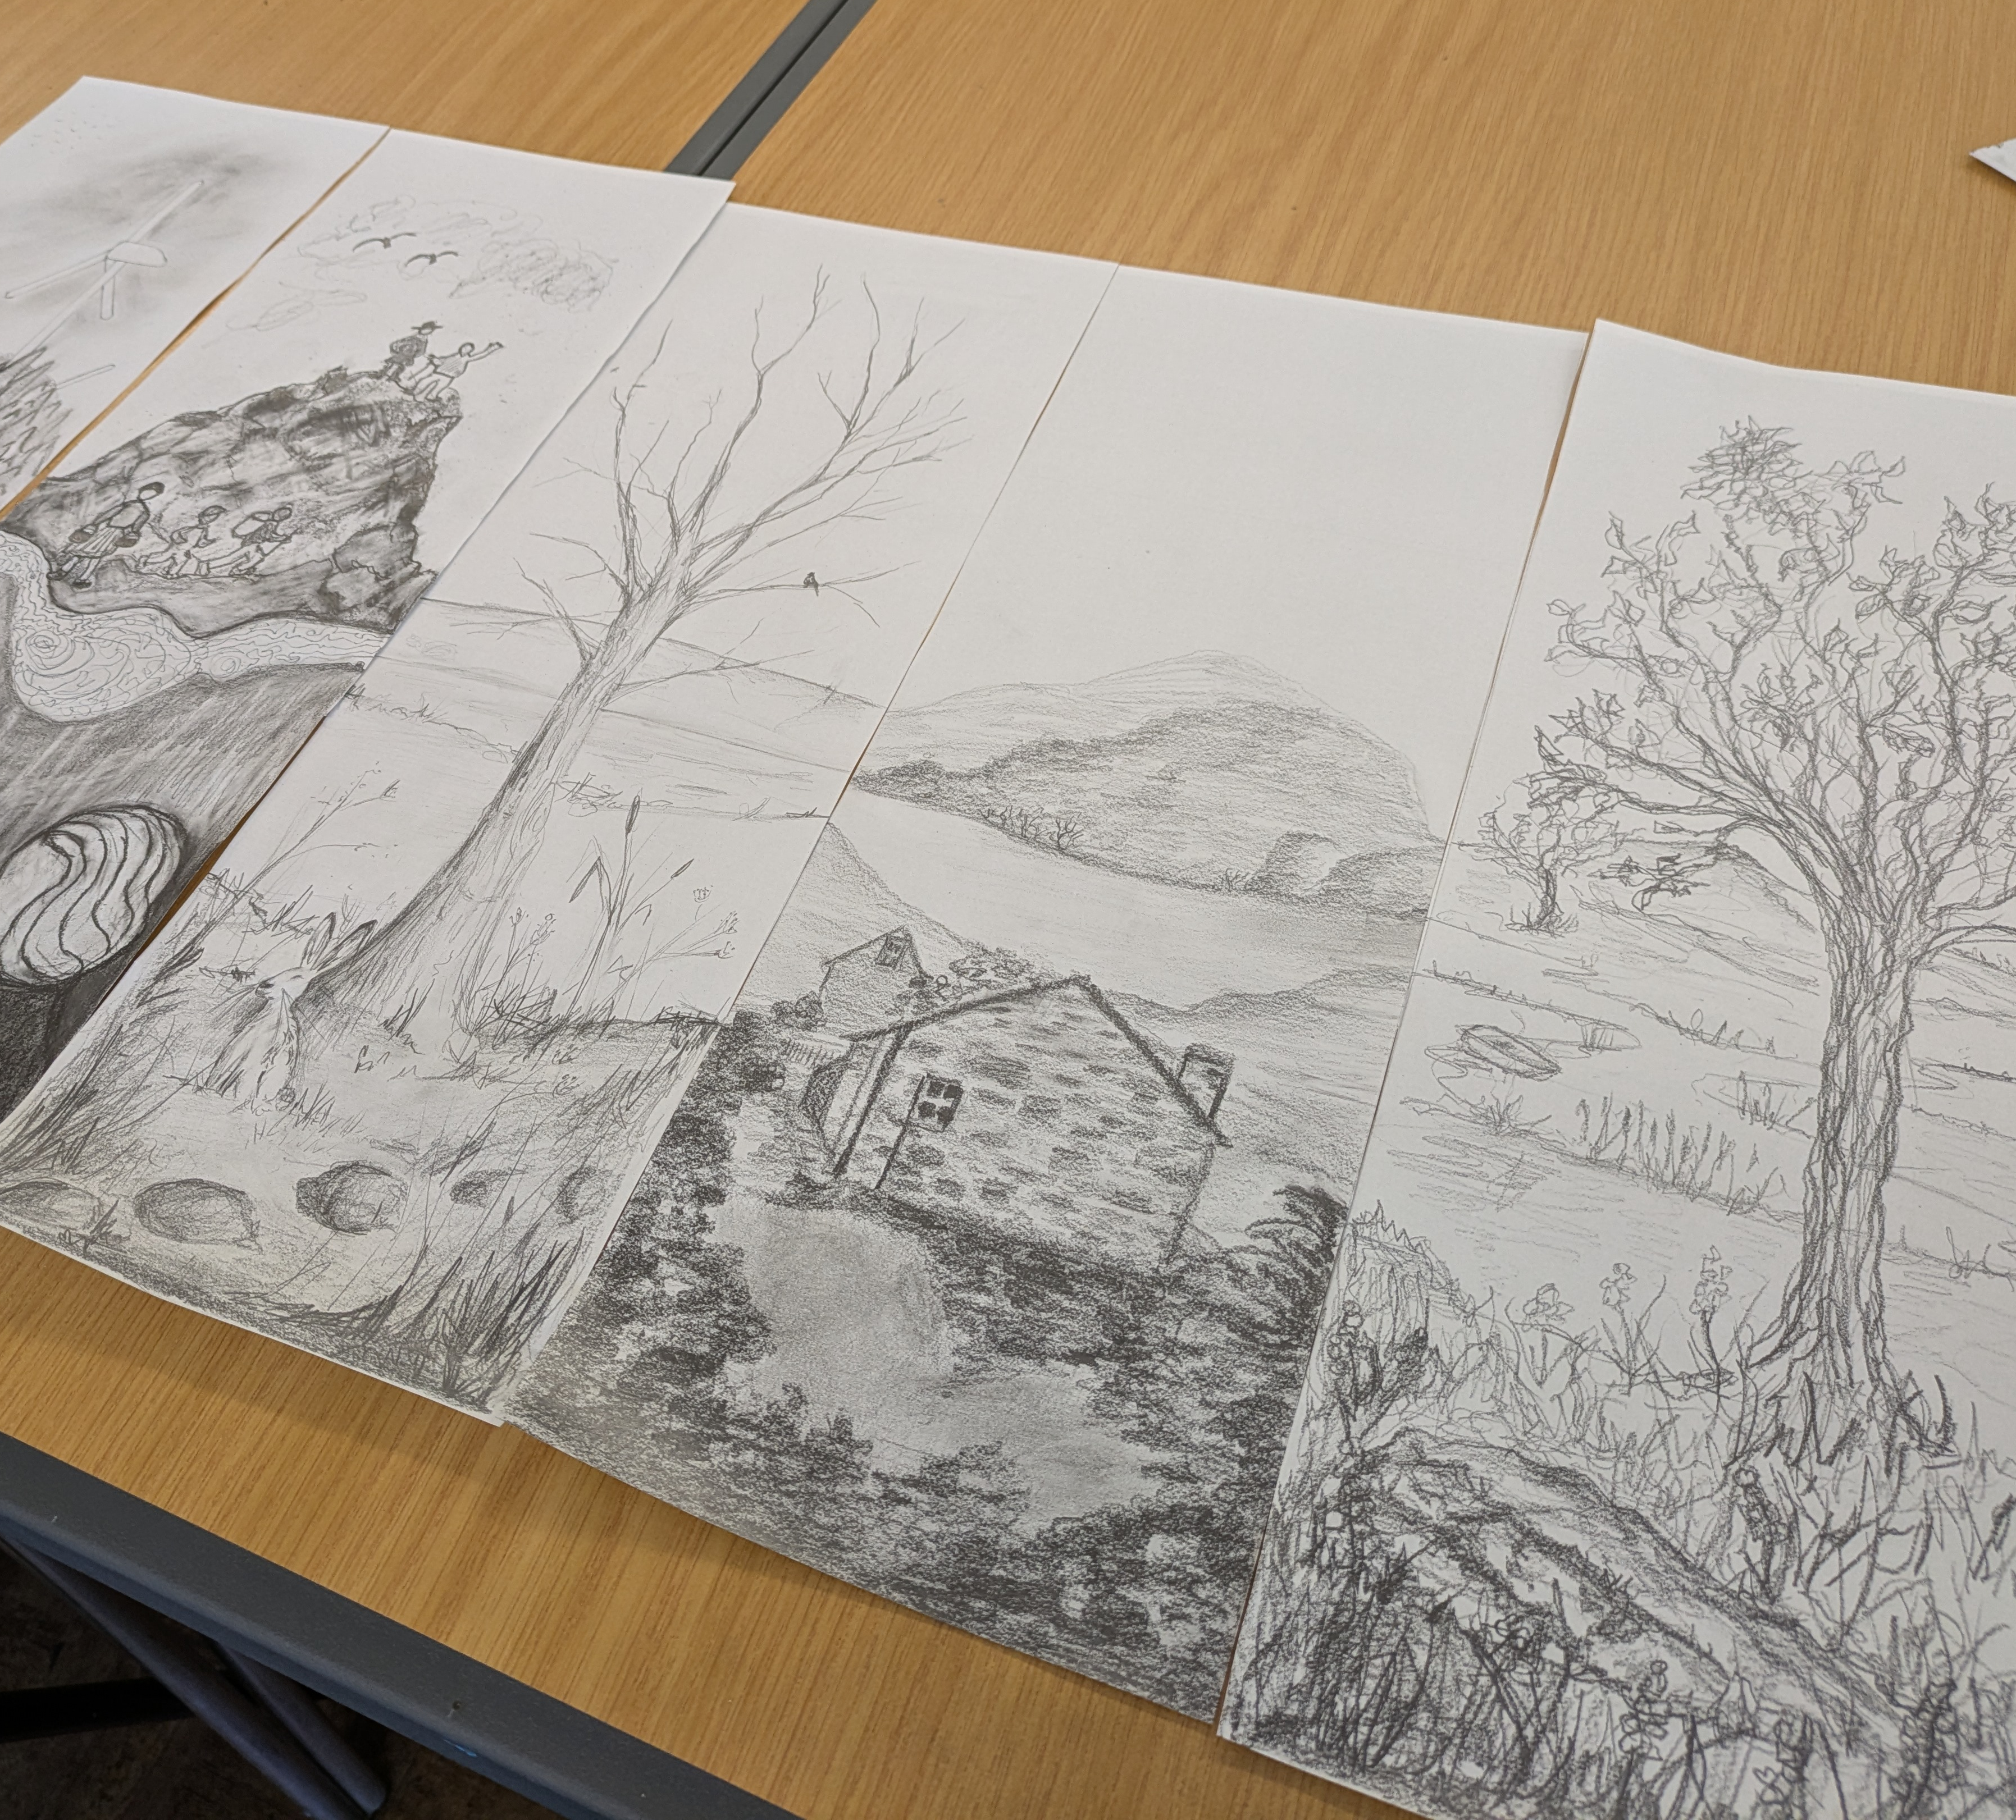
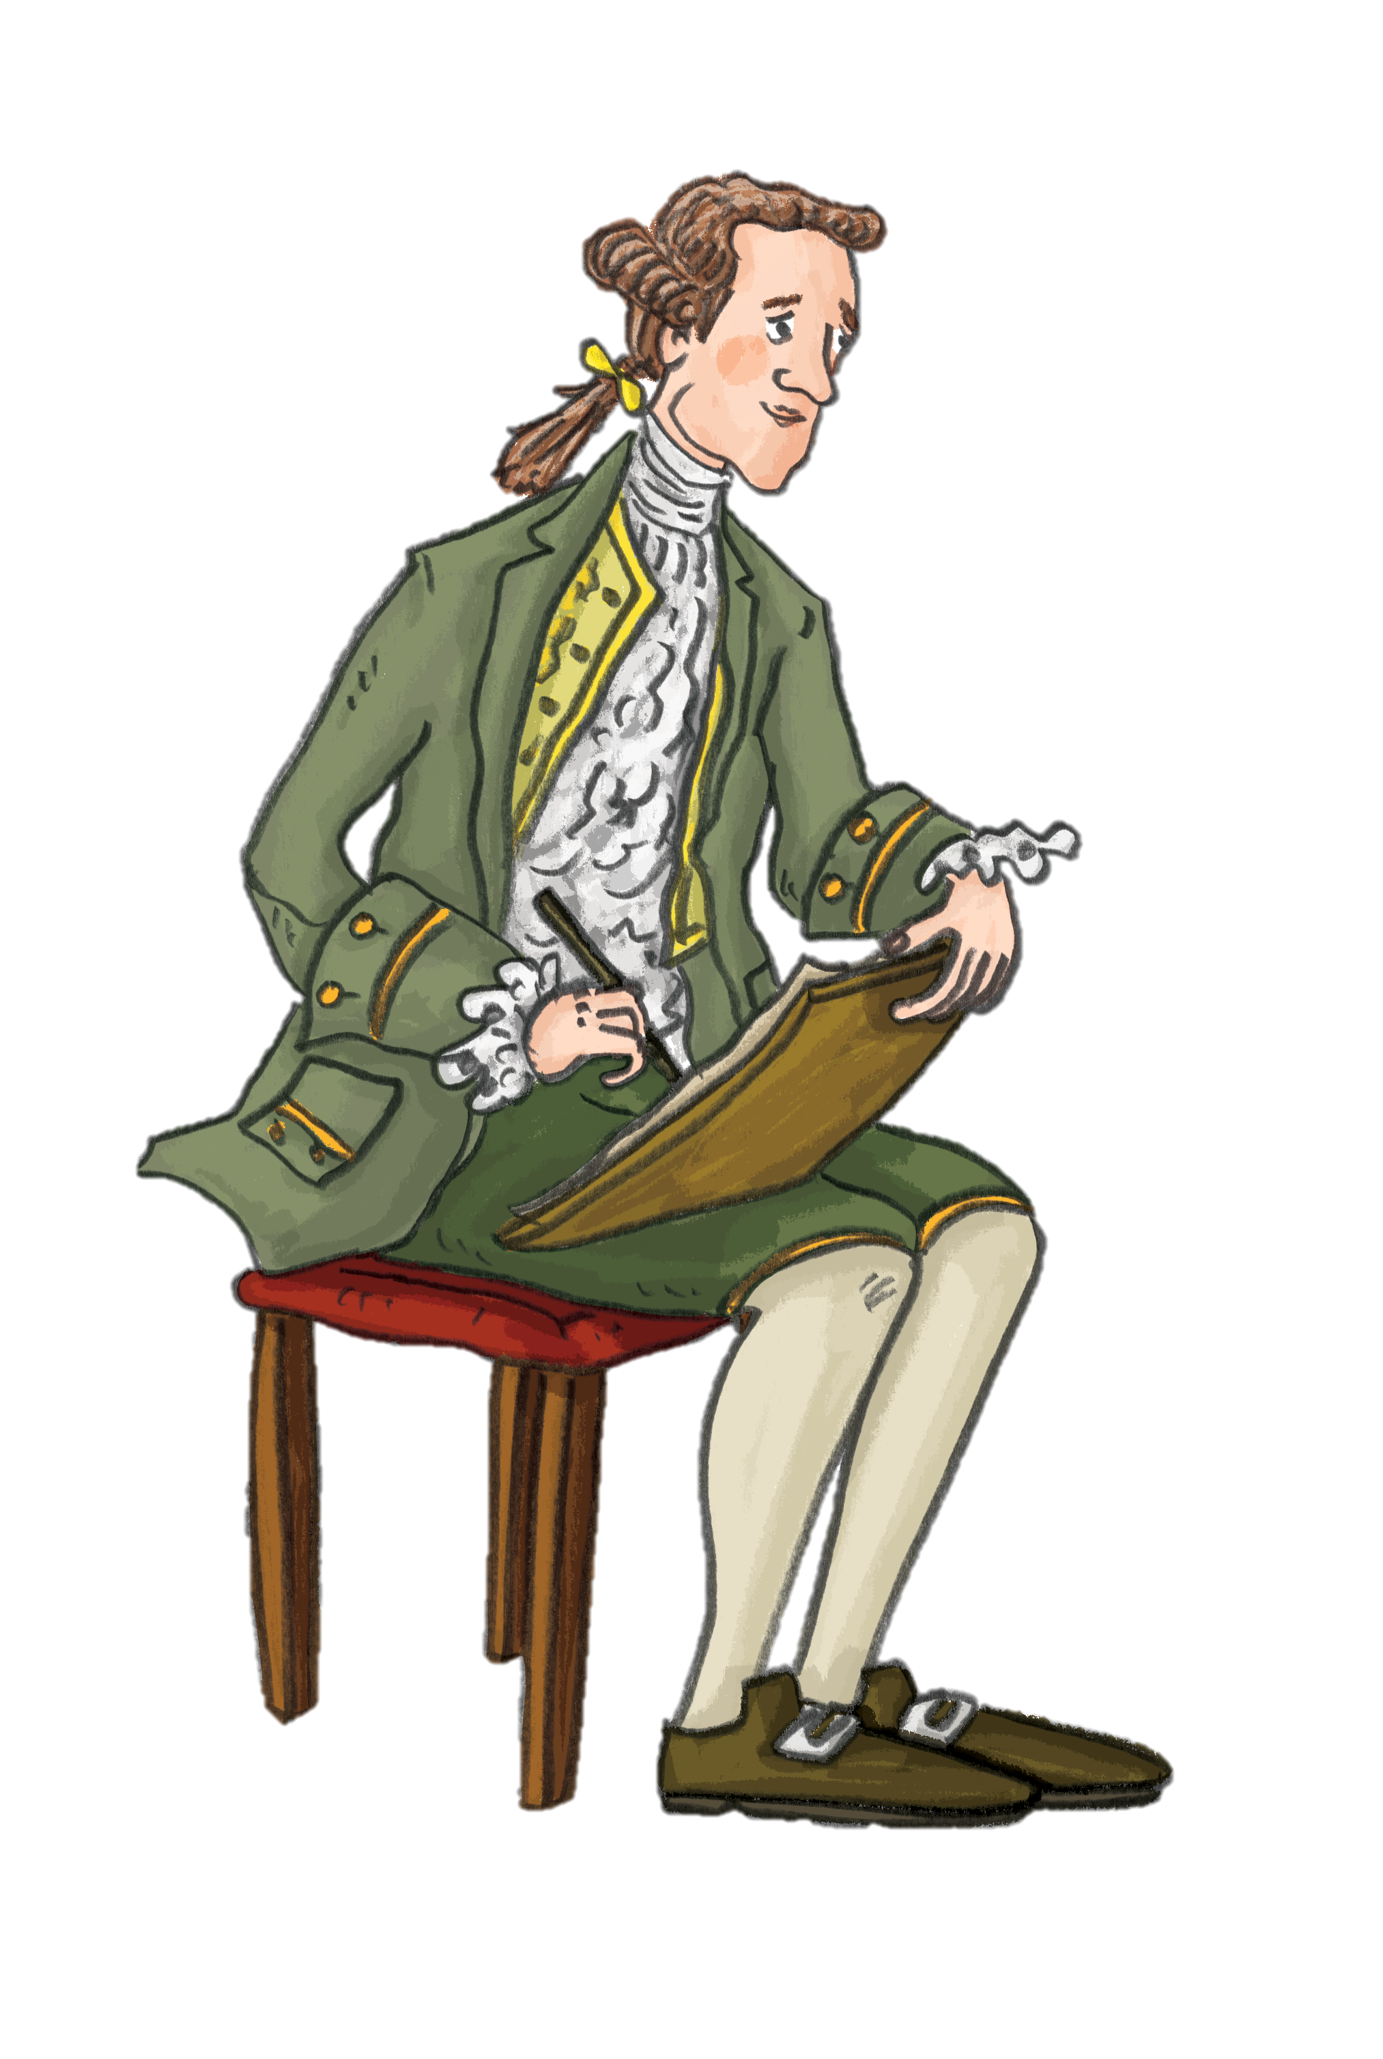
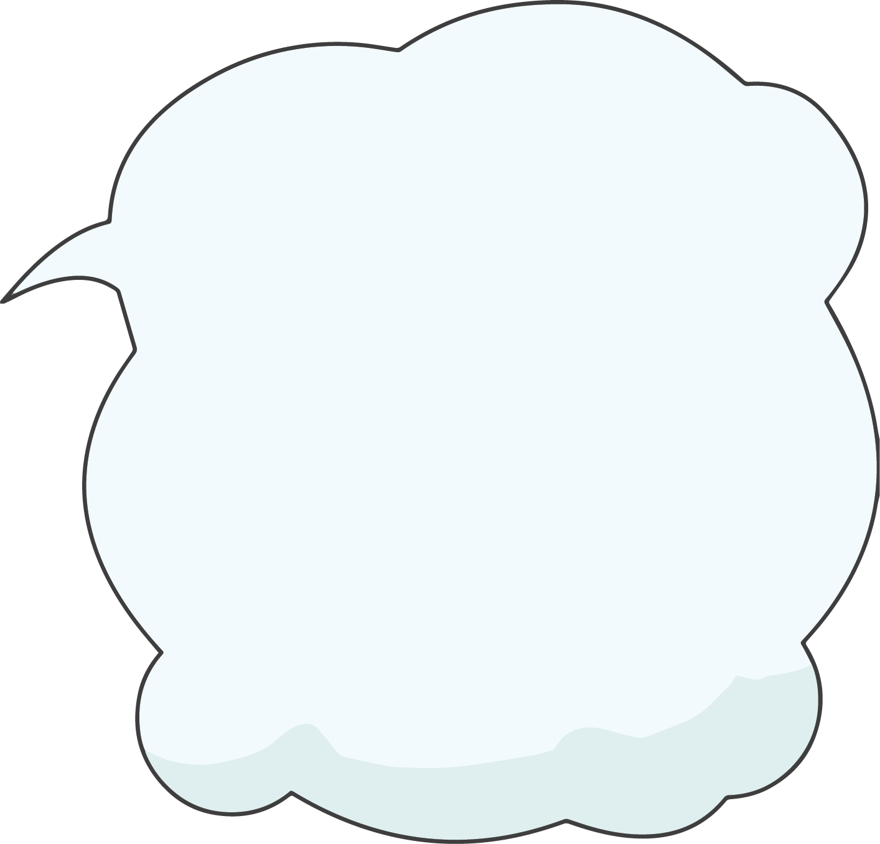
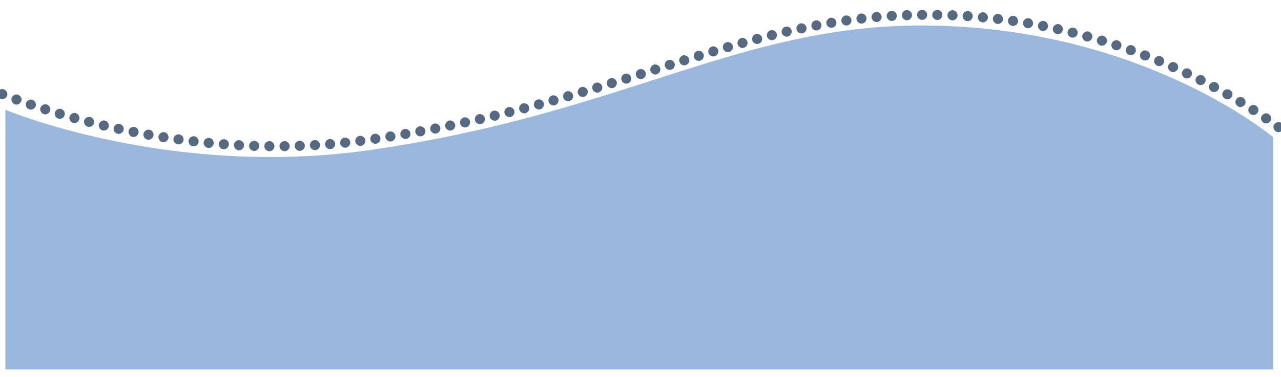
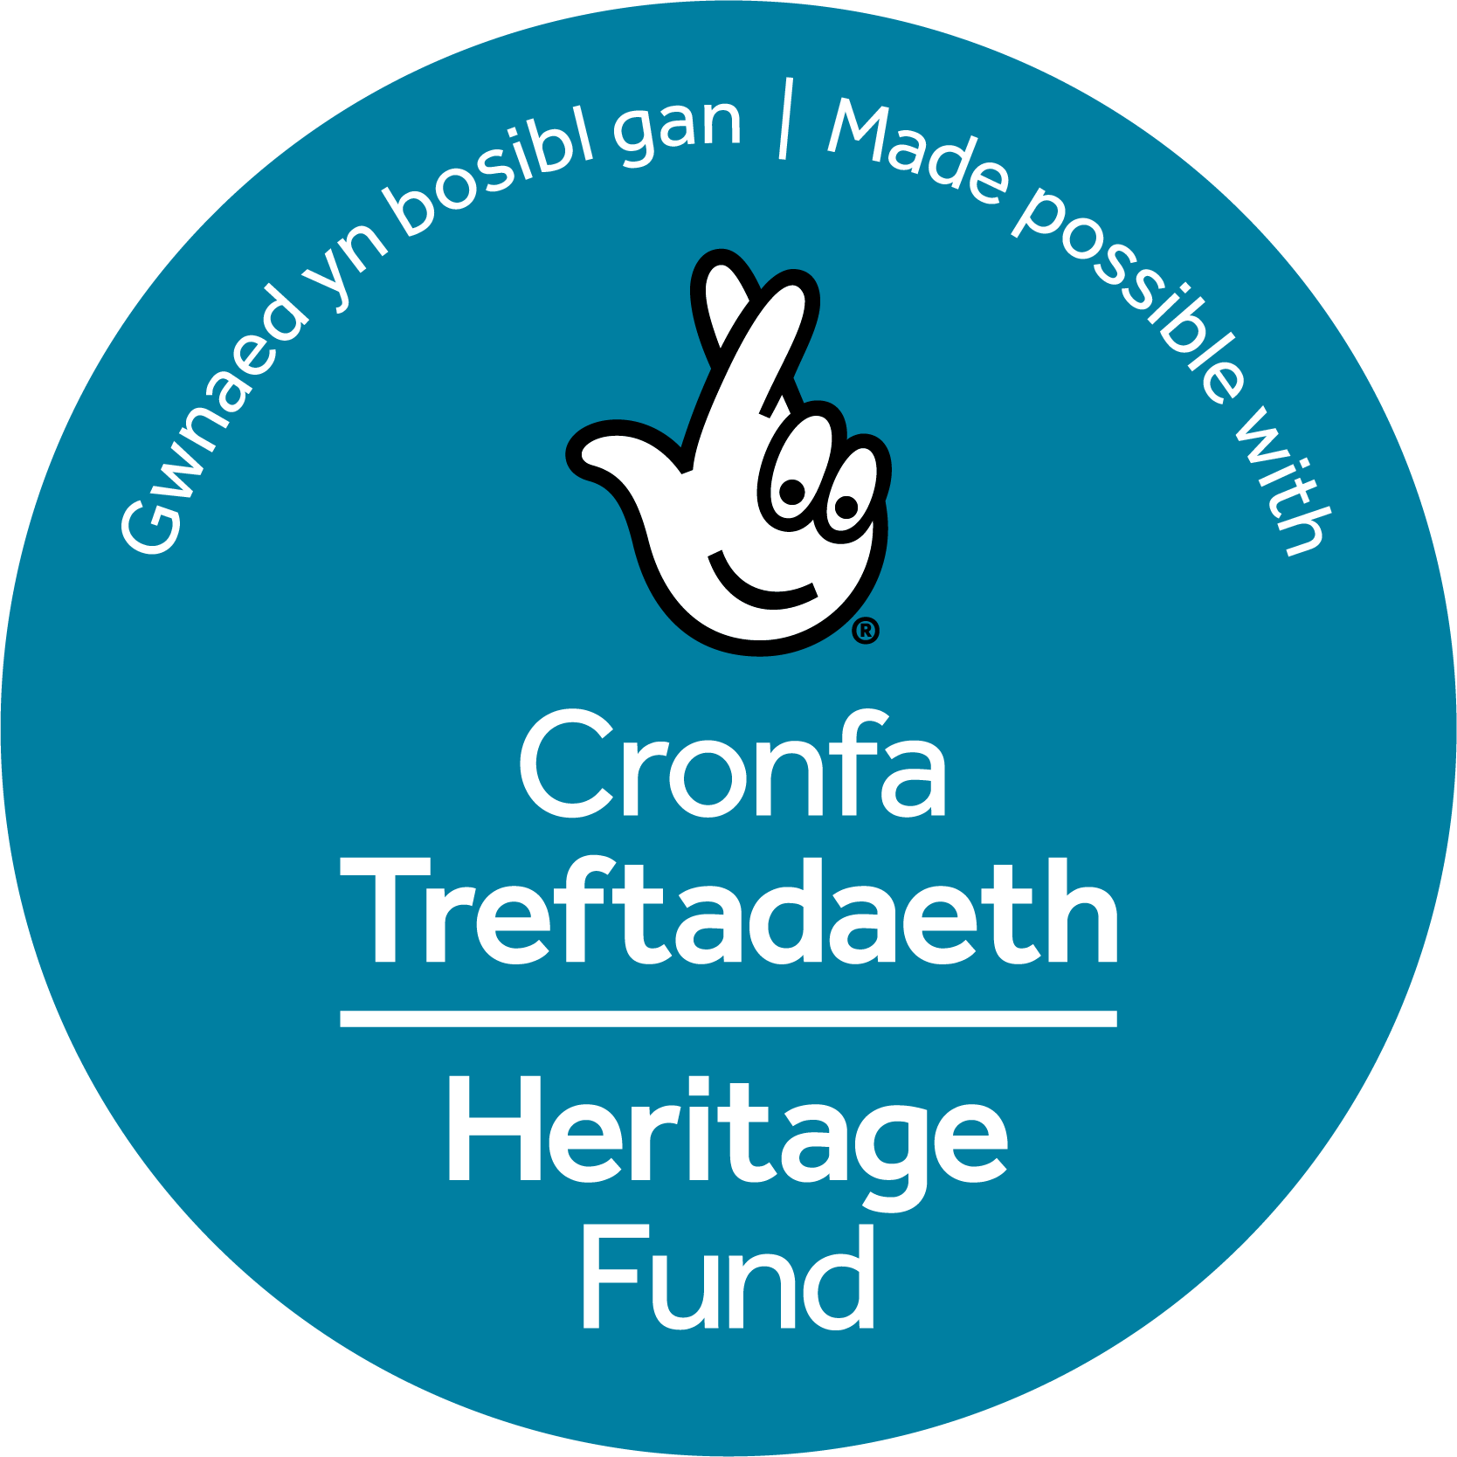
Make a Myriorama
Let’s make a myriorama inspired by the picturesque landscape of the Dee Valley!

Slide 2
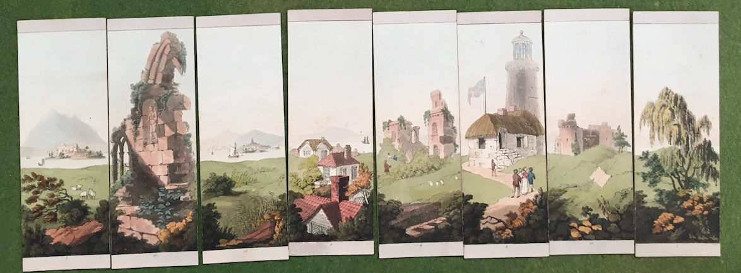
What is a myriorama?
In the early 1820s, a popular new toy came on the market known as the myriorama, the word simply means many views. A myriorama is a set of illustrated cards, each representing a slice of a landscape.
This picture shows one made in 1824, when myrioramas were a popular craze with adults and children.

Slide 3
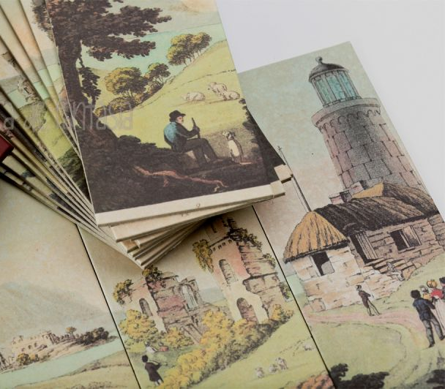
Why is it special?
Amazingly, a pack of just 12 cards can be rearranged in 479,001,600 different ways!
Each panel of a myriorama shows a different section of the landscape, when put together they make one long continuous scene.
The cards can be rearranged in any order to make an endless, changing landscape.

Slide 4
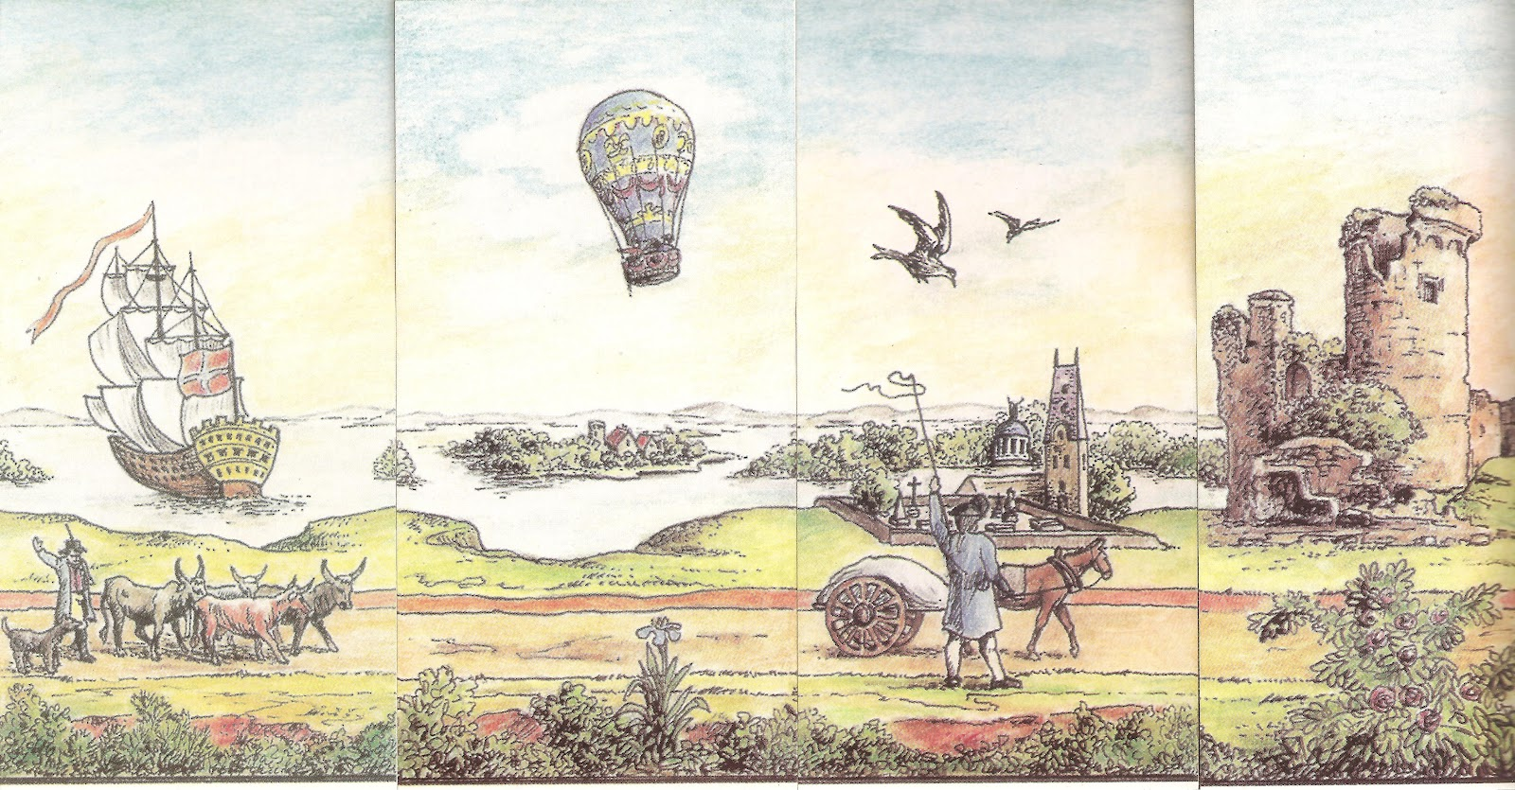
How does it work?
A myriorama can be as simple or complicated as you like, but the important thing is that each individual drawing needs to line up with all the others to make one long scene.
Look at the example, you can see that the horizontal lines running through the pictures all join at the same place.
As long as the edges of the cards match up, you can draw or paint any landscape features in the middle!

Slide 5
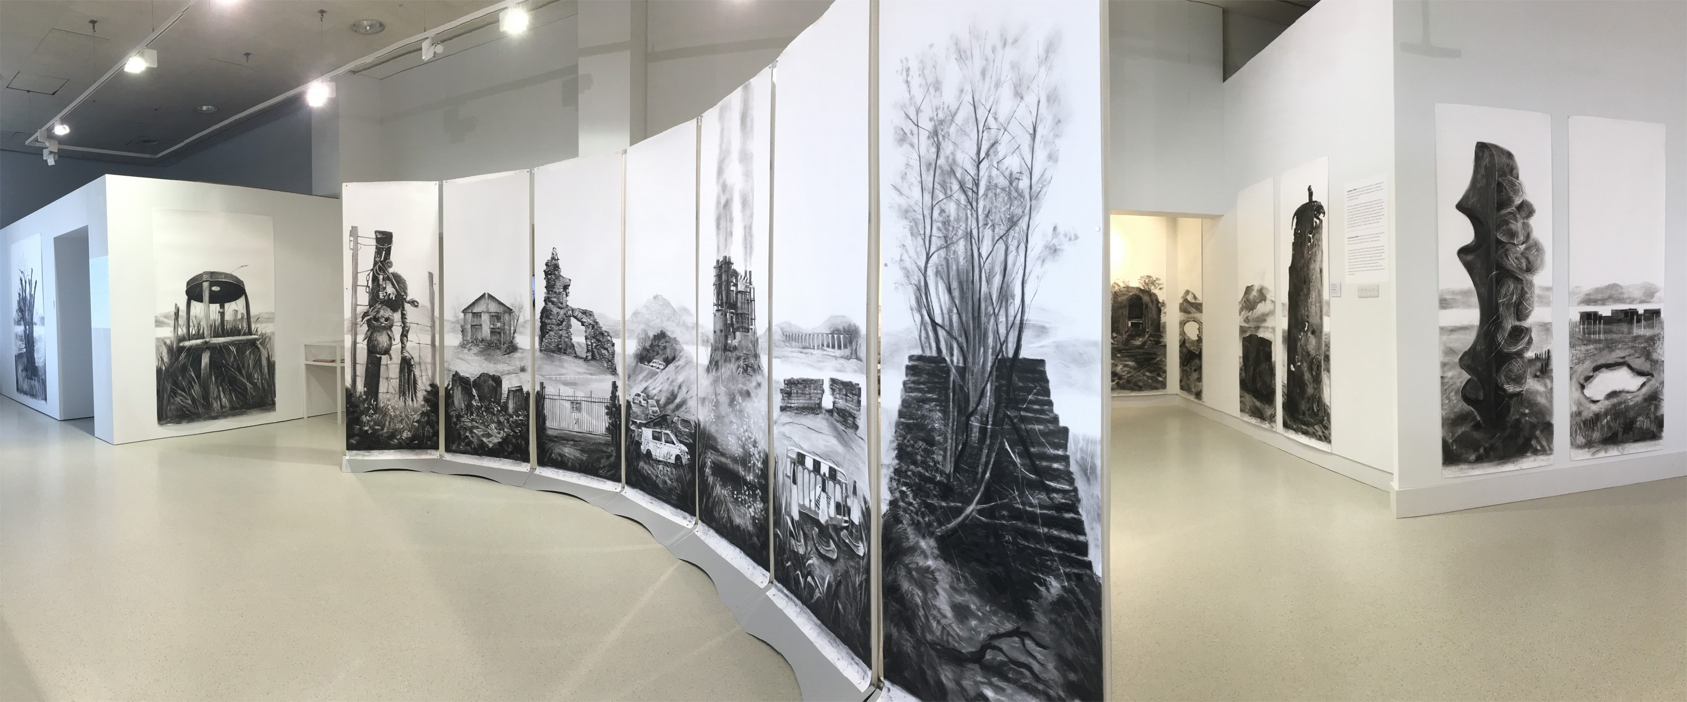
Inspiring artists today
These small Victorian cards are still inspiring artists today! Welsh artist Penny Hallas created a large scale myriorama based on the landscapes of the Dee Valley.
Penny’s work is thought provoking. It shows the picturesque beauty of the Dee Valley alongside some of the pressures facing the landscape.
How does this make you feel?

Slide 6
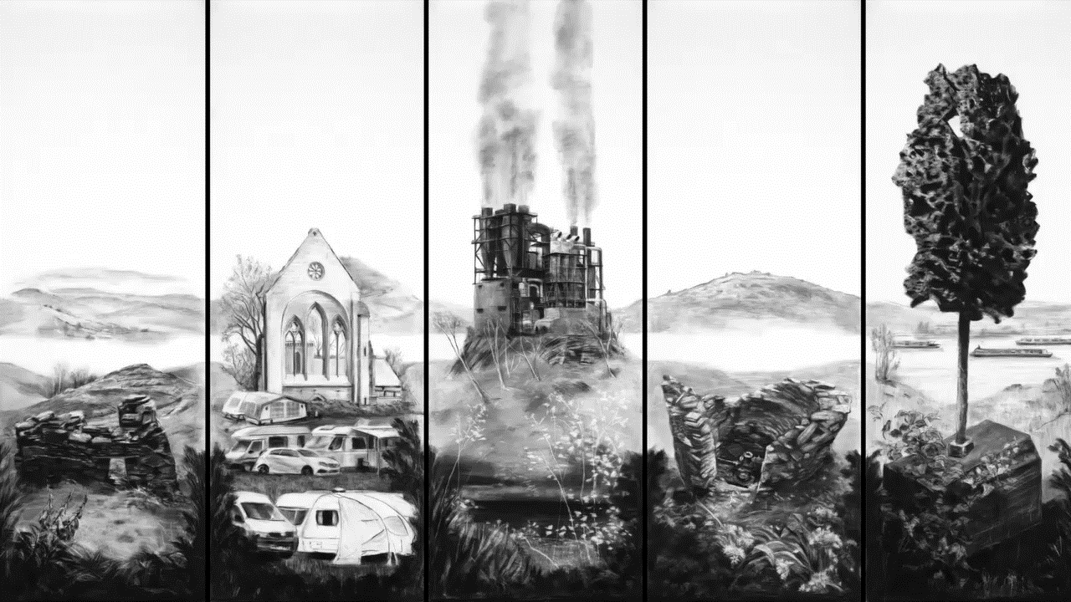
Can you identify any of the locations in the pictures or the pressures they face?

Slide 7

Let’s make our
own myriorama!
You will need:
  Paper or card
  Scissors
  Art materials - pens, pencils, paint, pastels, crayons
  Ruler
  Templates from this pack

Slide 8
Before you start…
Top Tip
It’s easier to make a myriorama using one colour, but once you’ve discovered how to do it, you can get more ambitious!
Myriorama cards can be any size. Make a small set first, then try a big one.
You can make a myriorama, on your own, or if everyone uses the same template, a whole group or community can mix and match pictures to make a giant landscape!
The main thing to remember is that the only part of your picture to touch the marks on the edge are your horizontal lines!

Slide 9
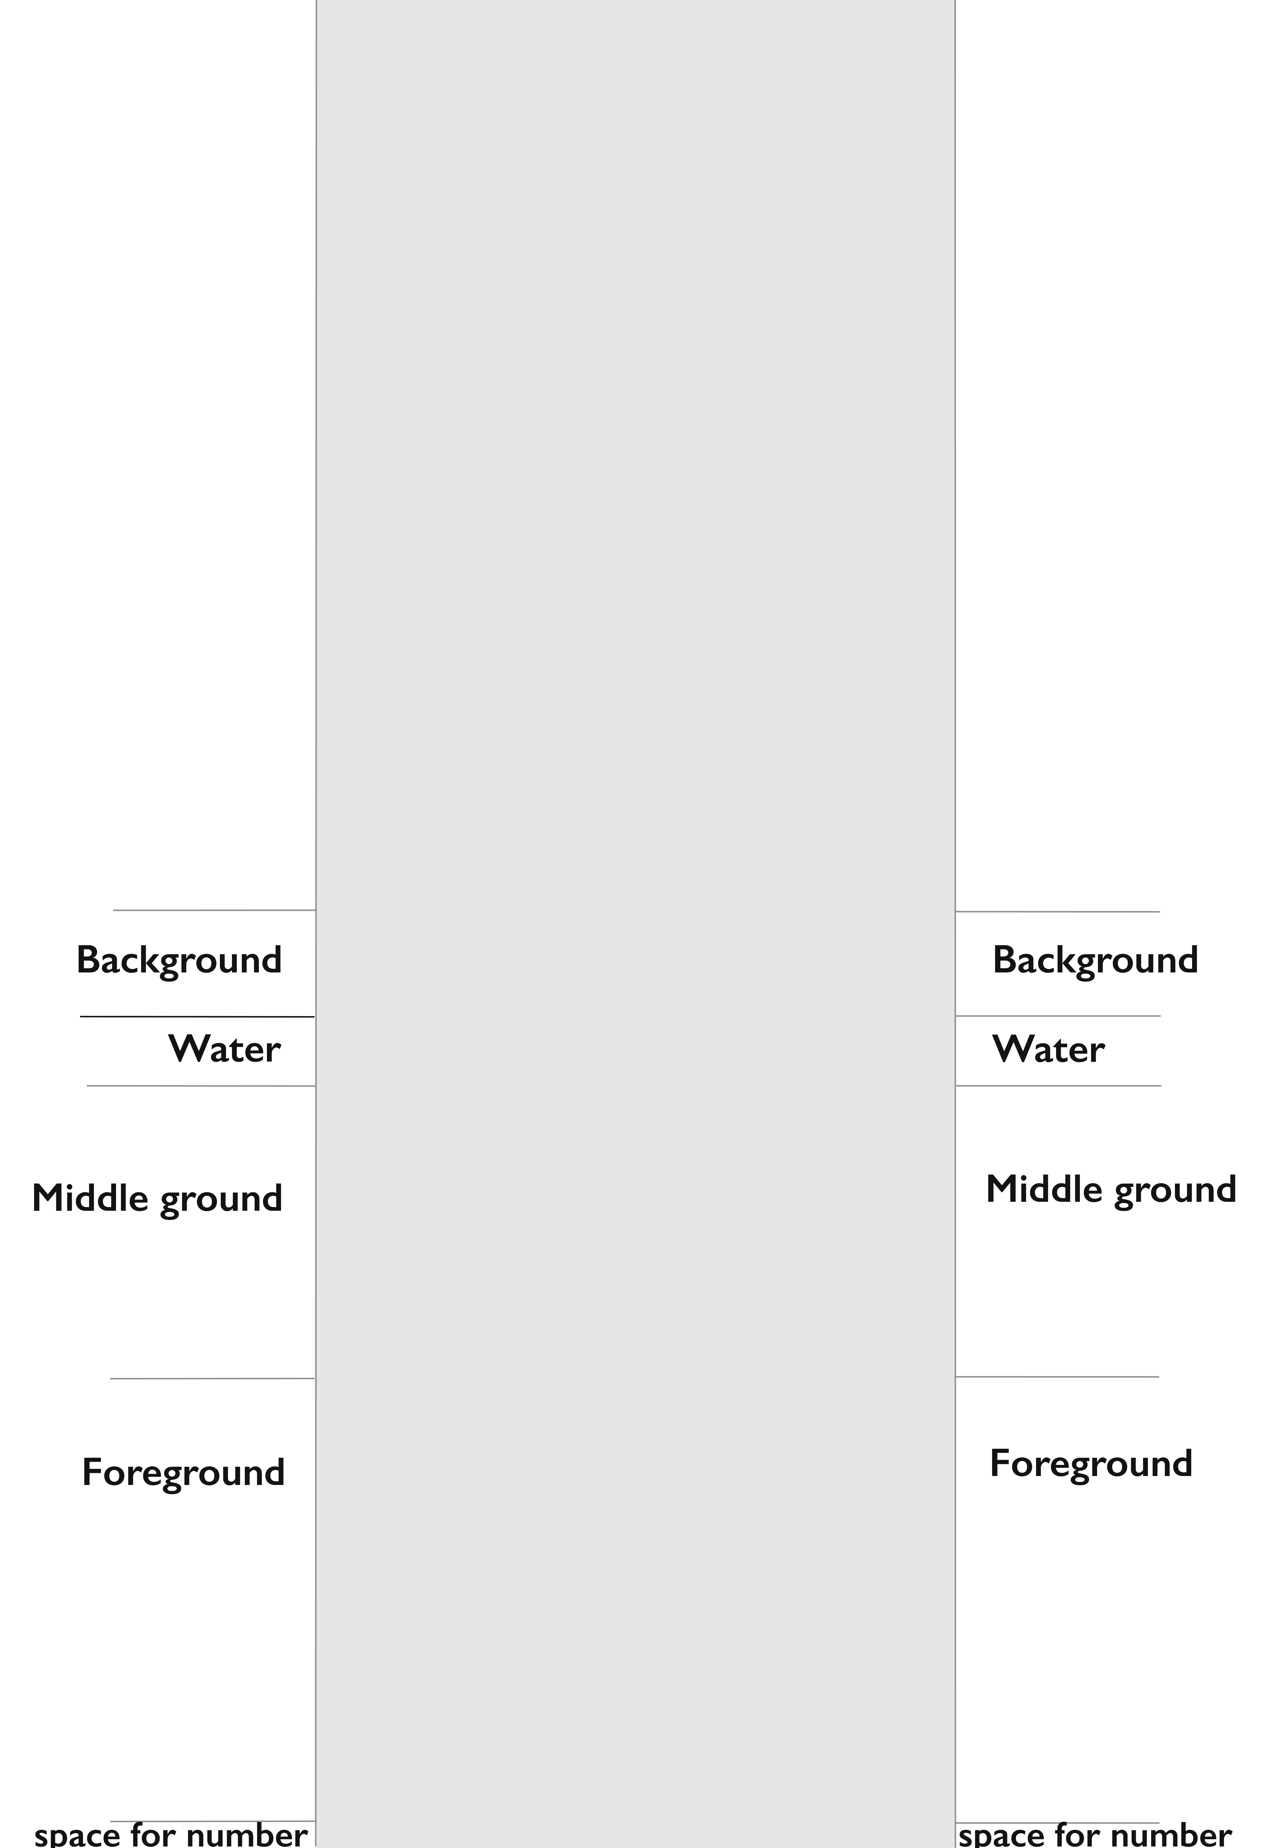
Step 1
  Print out the templates from this pack and cut out the set of cards (try 7cms x 20cms to start with).
  Make a mark on the edges of your cards to show where the horizontal lines need to line up.

Slide 10
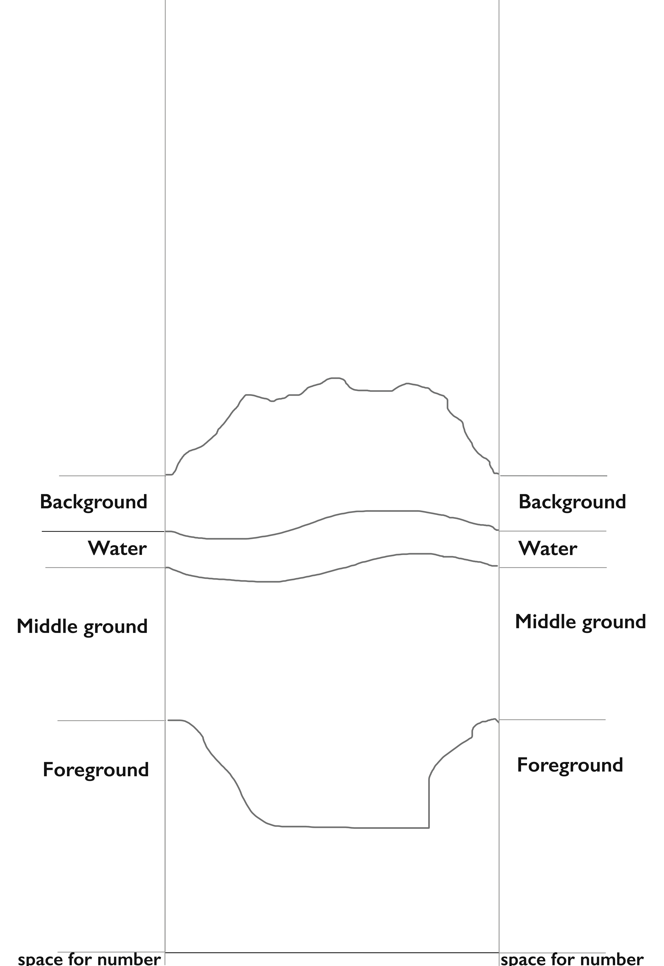
Step 2
  Think about the landscape you will draw. There will always be a…
  sky
  background
  band of water
  middle ground
  foreground

Slide 11
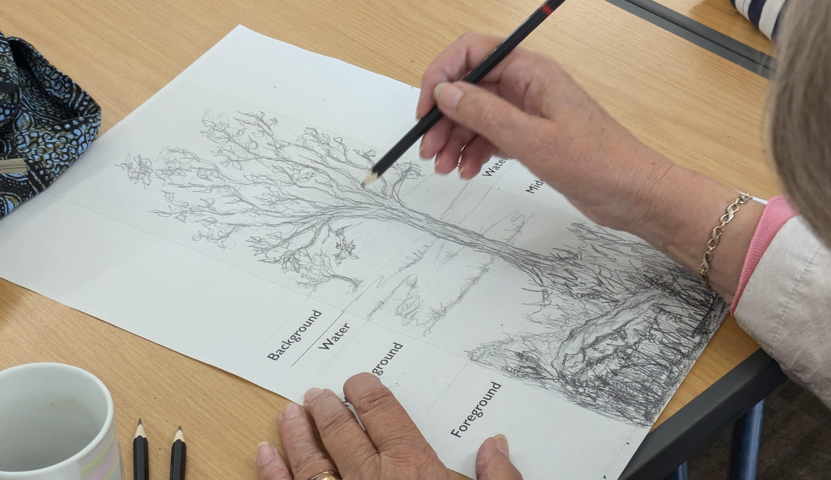
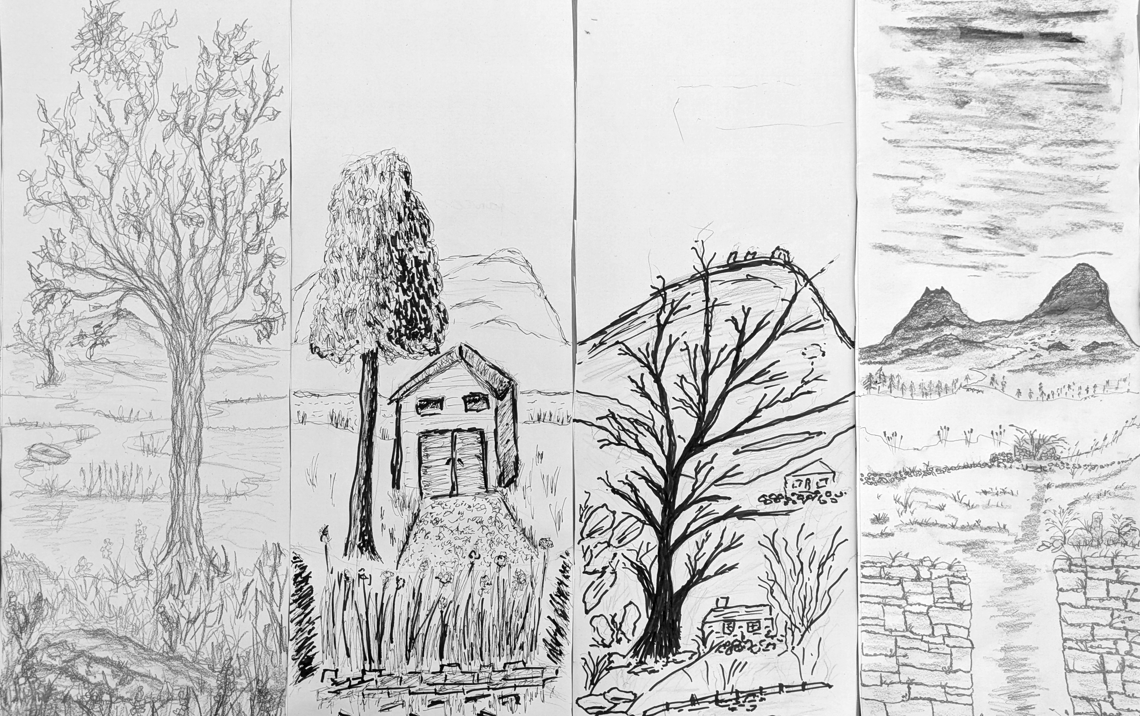
Step 3
  Using a pencil, start to draw in some of the hills, meadows, the river, and the grass. When you think they will work with other cards, you can start to think about what other features might be in the landscape.
Remember!
The only part of your picture that should touch the edge of the paper is your horizontal lines. Anything else won’t match up to the other cards!

Slide 12

Things to think about when creating your work…
  Do you have a favourite place?
  What do you want to see in the countryside?
  What would you like to see when you look out of your window?
  Think about what might be in your landscape in 100 years?
  Are there things you wish you didn’t have to see in the countryside?
  Imagine the landscape your favourite animal would like to see?

Slide 13
When you have made your cards:
  Arrange your scenes multiple times.
  Swap with other people in your group.
  Do the cards go together?
  Do you have a favourite order?
  What's the story? Create a story based on one of your landscapes.

Slide 14
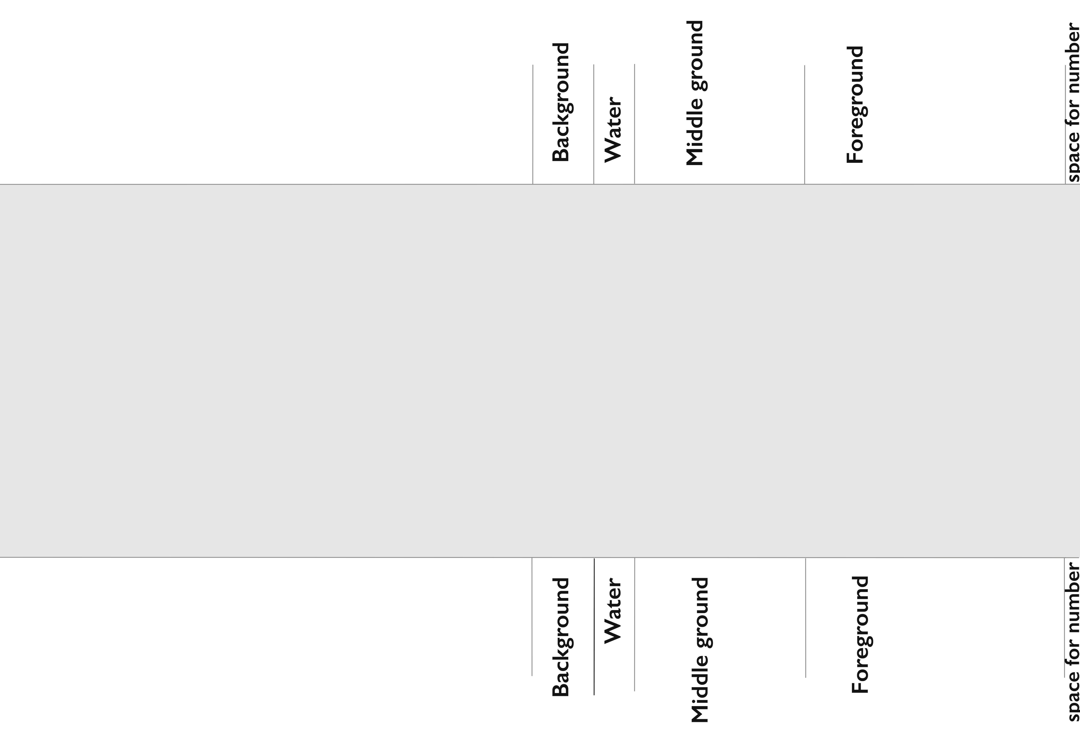
Myriorama Template

