Slide 1

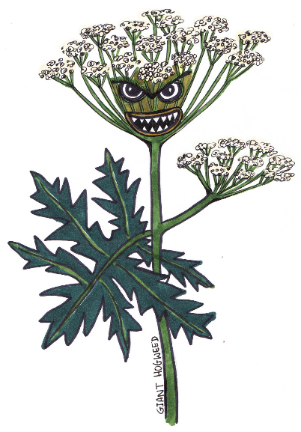



Ecosystem Invaders
I’m a Giant Hogweed.
Let’s learn about different invasive species in our local environment.

Slide 2



Ecosystem Invaders – Classroom Lesson
Learning Objective:
Learn about different invasive species in our local area
Success Criteria
I can research about one type of invasive species.
I can work with other people.
I can present my research to others.

Slide 3
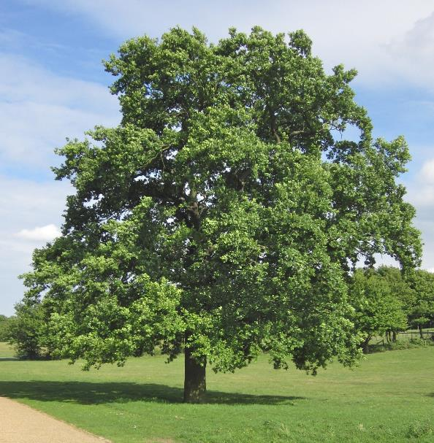
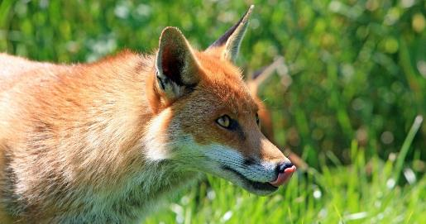
Native Oak
Native species
Some species of wildlife are native, such as the fox and the oak tree, they arrived in the United Kingdom by natural processes in prehistoric times.
Native fox
© Tree Guide UK

Slide 4
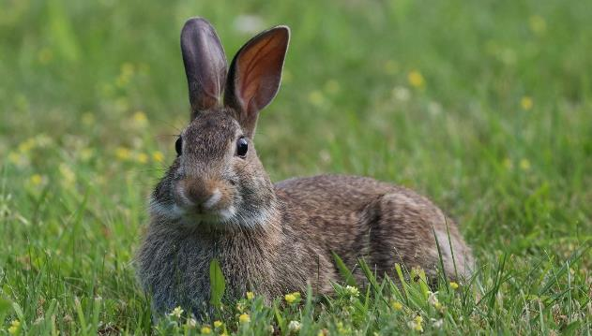

Non-native or naturalised species
Some species arrived in the UK by human actions and are known as non-native or naturalised. Many have been here for centuries and live happily without significantly effecting other wildlife.
Non-native naturalised Rabbit
Non-native, naturalised species are different to invasive species because they cause little or no harm to the environment and other species.

Slide 5

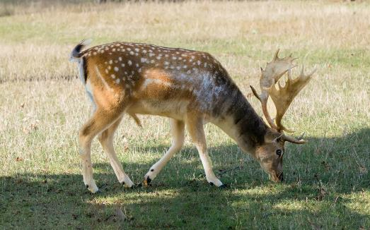
Non-native species
The Romans introduced non-native rabbits, fallow deer and pheasants to the United Kingdom.
As a class discuss the following:
Why do you think the Romans wanted these animals here?
Do you think these species are invasive?
Non-native Fallow Deer
Notes:
The Romans when they occupied Britain (AD 43–410) introduced lots of new species, we know this because of archaeological research.
Like the Romans but on a larger scale the Normans in the 1100s imported really large numbers of rabbits and deer for food.

Slide 6
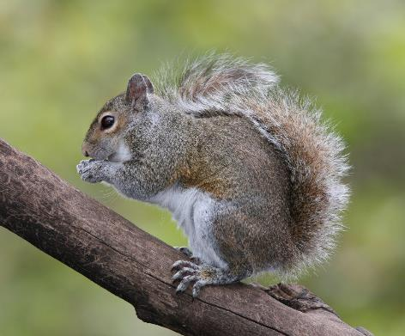
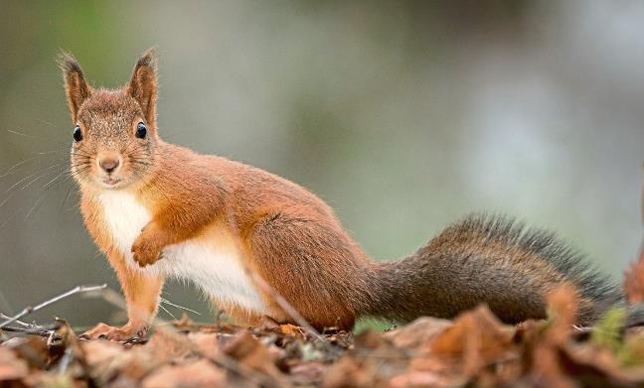
Non-native species
Grey squirrels are from North America and were introduced to the UK in the 1800s, however they are a problem species for us today.
© BirdPhotos.com via Wikimedia Commons
Native Red Squirrel
Non-native Grey Squirrel
© Geert Weggen
Notes:
Red squirrel populations have been in some areas have been lost completely by the pox virus. It is important to keep populations safe and away from grey squirrels. There is a campaign to research into vaccinating the squirrels.
There are only about 1,000 red squirrels left in north Wales, mostly on Anglesey.

Slide 7


Why are grey squirrels a problem?
They threaten our native red squirrels by spreading squirrel-pox disease and competing for food.
Damage trees by eating bark.
Eat and store unripe hazel nuts and acorns in vast quantities impacting the tree’s life cycles.
Do you think grey squirrels are an invasive species?
Notes:
Red squirrel populations have been in some areas have been lost completely by the pox virus. It is important to keep populations safe and away from grey squirrels. There is a campaign to research into vaccinating the squirrels.
There are only about 1,000 red squirrels left in north Wales, mostly on Anglesey.

Slide 8
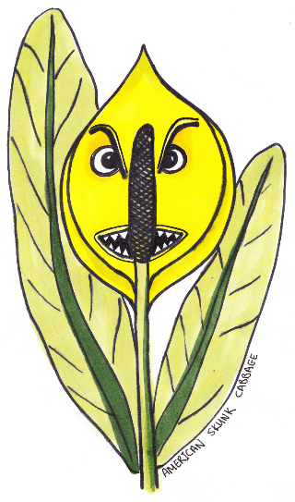
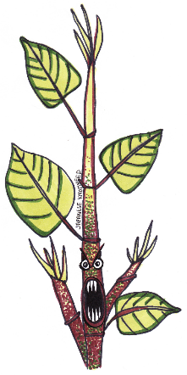
What is an invasive non-native species?
Plants or animals that have been introduced by humans to places where they wouldn’t naturally be found.
They can impact the environment, economy, our health and the way we live.

Slide 9
Top threats to our native wildlife:
Invasive Species
Pollution
Changes in land and sea use
Unsustainable use of species
Climate change
Notes:
Our canals and rivers are home to many invasive species and the water flow means that they spread fast.
The impact of non-native invasive species costs the UK economy approximately £1.7 billion a year.
In the Dee Valley the ranger team and North Wales Wildlife Trust and volunteers work hard to prevent the further spread of two major invasive species Himalayan Balsam and Japanese Knotweed especially along the River Dee itself.

Slide 10




Task
In pairs, use the internet to find out about an invasive species from the next page and tell your class all about it.
Put these phrases into a search engine to help you find out more:
North Wales Wildlife Trust Ecosystem Invaders
Canal and River Trust Invasive Species Control
What is it?
What does it look like?
How did it get here?
Why is it a problem?
What can people do to help control it?
Notes:
Find some images of your invasive species, draw or print a species and make a spider diagram or poster to answer the questions.
You will then present this to the class so you can learn about the different invasive species.

Slide 11
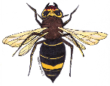

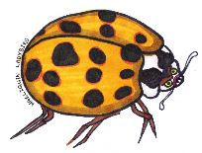
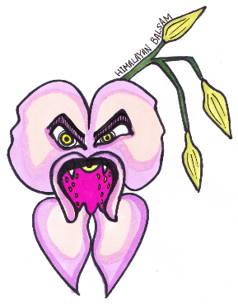
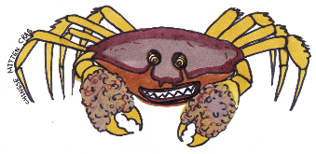
Invasive Species to research:
Japanese knotweed
Himalayan balsam
American signal crayfish
Giant hogweed
Killer shrimp
American skunk cabbage
Asian hornet
Harlequin ladybird
Chinese mitten crab

